Slide 1
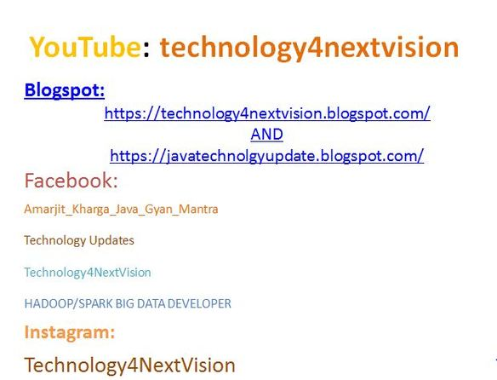

Slide 2
Would you be able to Control Logging with Spring Boot? How?
Yes, we can control logging with spring boot.

Slide 3
Differentiate Between An Embedded Container And A War?
There is no force to go containerless
• The embedded container is only one component of Spring Boot
• Traditional WAR additionally benefits a considerable measure from Spring Boot
• Automatic Spring MVC setup, including Dispatcher Servlet
• Sensible defaults in light of the class-path content
• The embedded container can be utilized during improvement.

Slide 4
What does Spring Security mean?
Spring Security is a groundbreaking and very adjustable authentication and access-control structure. It is the true standard for securing Spring-based applications. Spring Security is a system that spotlights on giving both authentication and approval to Java applications. Like all spring ventures, the genuine power of Spring Security is found in how effectively it can be reached out to meet custom prerequisites.

Slide 5
What does Aspect-Oriented Programming (AOP) mean?
Aspect Oriented Programming (AOP) supplements Object-Oriented Programming (OOP) by giving another mindset about program structure. The key unit of measured quality in OOP is the class, while in AOP the unit of particularity is the viewpoint. Angles empower the modularization of concerns, for example, transaction management that cut over numerous sorts and questions.

Slide 6
Describe some of the spring sub-projects briefly?
Various spring sub-projects are as follows:
• JDBC: this module empowers a JDBC-deliberation layer that evaluates the need to do JDBC coding for particular vendor databases
• Core: a key module that gives basic parts of the system, as IoC or DI
• Web: a web-situated joining module, giving multipart document upload, listeners members, and web-arranged application context functionalities

Slide 7
Continue…
ORM integration: gives mix layers to well-known protest object-relational mapping APIs, for example, JPA, JDO, and Hibernate
• AOP module: perspective oriented programming execution is permitting the meaning of clean strategy interceptors and pointcuts.
• MVC system: a web module executing the Model View Controller configuration design

Slide 8
Explain the difference between JPA and Hibernate?
JPA is a specification/Interface whereas Hibernate is one of the JPA implementations.

Slide 9
How to connect to an external database like MSSQL or oracle with Spring boot?
It is done in the following steps.
Step 1 -
The first step to connect the database like Oracle or MySql is adding the dependency for your database connector to pom.xml.
Step 2 -
The next step is the elimination of H2 Dependency from pom.xml

Slide 10
Continue…
Step 3 includes the schema and table to establish your database.
Step 4 -
The next step is configuring of the database by using Configure application. Properties to connect to your database.
Step 5-
And the last step is to restart your device and your connection is ready to use.

Slide 11
How to add custom JS code in Spring Boot?
/src/main/resources/static. is the suggested folder for static content.
You can create a JS file by sending an alert
/src/main/resources/static/js/custom.js
alert("I'm active");

Slide 12
List minimum requirements for Spring boot System?
Spring Boot 1.5.10. RELEASE requires
• Java 7 +
• Spring 4.3.13 +
For build support
• Maven 3.2+
• Gradle 2.9+
Container Support
• Tomcat 7+
• Jetty 8+ (Jetty 9.3 requires JDK 8 +)

Slide 13
What is Auto Configuration?
Spring Boot Auto Configuration comes with these features. Auto-Configuration will attempt to automatically try to set up our application with default behavior based on the jars in the classpath. For example, if Spring Boot finds HSQLDB in out classpath, it will automatically configure an in-memory database for us. Think of the auto-Configuration as an intelligent system which can provide ready to use the application to us based on the configured jars in our classpath.
In our sample application, we never defined any dispatcher servlet or configured tomcat for the deployment, however, we can still find Mapping servlet: 'dispatcher Servlet' to [/] in the console, this is

Slide 14
Continue…
happening because we added spring-boot-starter-web in our application using POM.xml
<dependency>
<groupId>org.springframework.boot</groupId>
<artifactId>spring-boot-starter-web</artifactId>
</dependency>
This single entry demonstrates power and feature of auto-configuration. On adding this starter in our application, Spring Boot auto configuration understands that we are building an MVC application and it added all required dependencies in our classpath for a Spring MVC web application.
This went one step ahead and automatically configured DispactherServlet, CharacterEncodingFilter, RequestContextFilter and even error page for us (We never did any configuration for these). Spring Boot will add similar configurations based on the Spring Boot Starters added in the POM file.

Slide 15


